Slide 1

Table of contents
The Importance of Stochastic models
Stochastic models in finance
SDG
Conclusions
Application of the model
Introduction to Fundamental
Techniques in Econophysics
with Python Simulations
Author : Jon Rodriguez Gonzalez
Tutor: Josu Mirena Igartua

Slide 2
Introduction / Motivation
The Importance of Stochastic models
Stochastic models in finance
Application of the model
Conclusions

Slide 3
Introduction
The Importance of Stochastic models
Stochastic models in finance
Conclusions
Application of the model
SDG
Describe the basic models from Econophysics
Evolve towards innovative approaches
Guide our way trough with illustrative Python simluations
1
2
3

Slide 4
Introduction
The Importance of Stochastic models
Stochastic models in finance
Conclusions
Application of the model
SDG
Describe the basic models from Econophysics
Evolve towards innovative approaches
Guide our way trough with illustrative Python simluations
1
2
3
Motivation
Urge to describe complex phenomena
Continuity of past work from Naia Ormaza
Interdisciplinary applications of physics
1
2
3

Slide 5
Introduction / Motivation
The Importance of Stochastic models
Stochastic models in finance
Application of the model
Conclusions

Slide 6
SDG
The Importance of Stochastic models
The Importance of Stochastic models
Application of the model
Classical / Quantum noise
Brownian motion

Slide 7
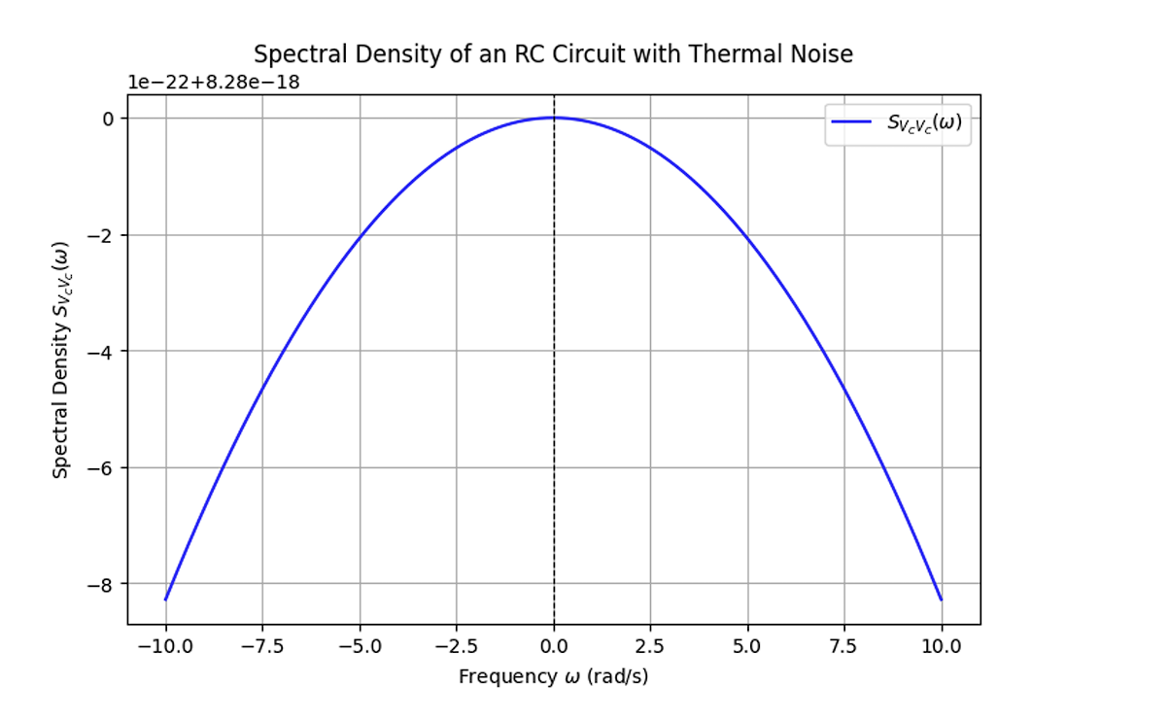
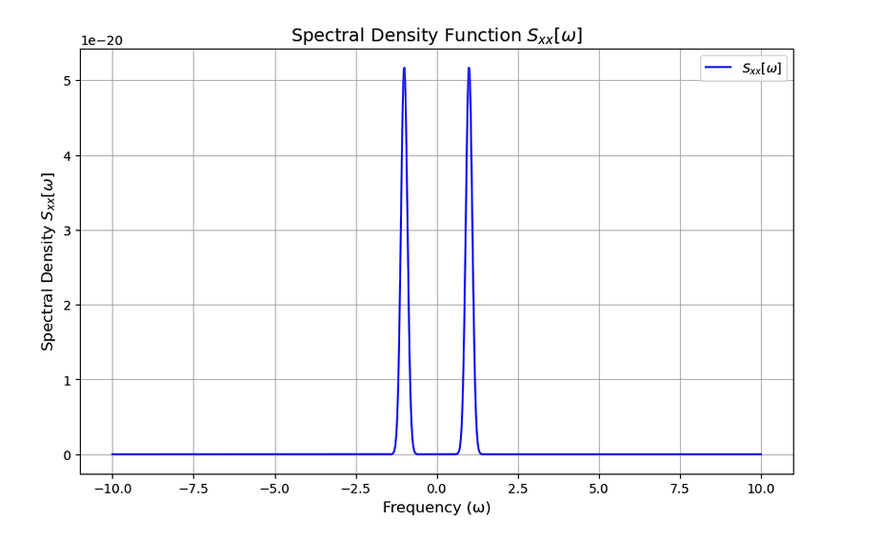
SDG
The Importance of Stochastic models
The Importance of Stochastic models
Application of the model
Classical and Quantum noise
RC Circuit
Classical Harmonic Oscillator

Slide 8
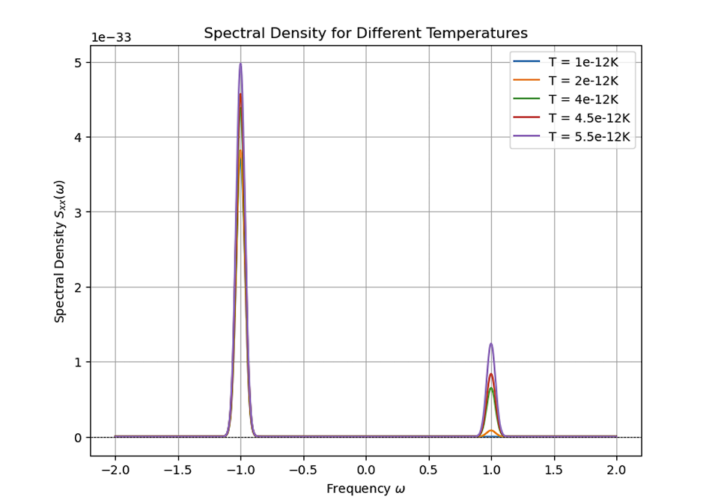
SDG
The Importance of Stochastic models
The Importance of Stochastic models
Application of the model
Classical and Quantum noise
Classical Harmonic Oscillator
Quantum Harmonic Oscillator

Slide 9
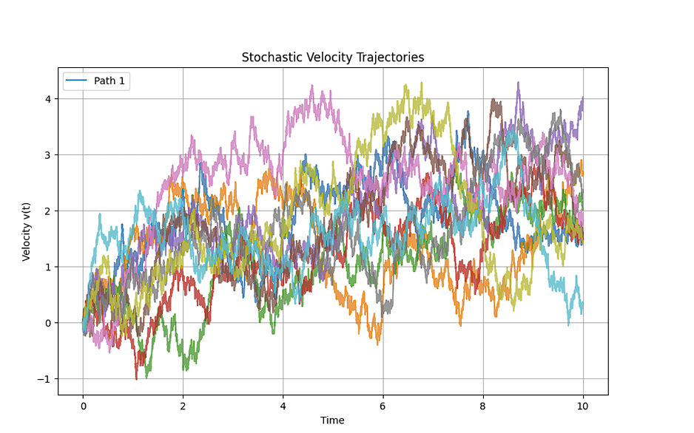
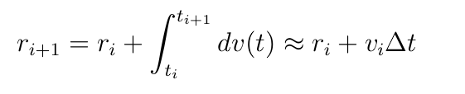
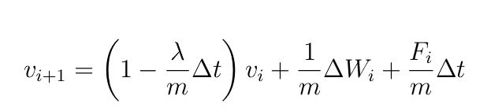
SDG
The Importance of Stochastic models
The Importance of Stochastic models
Application of the model
Brownian motion
The force is taken to be F=F(x), so there is a preferred direction towards the positive X values

Slide 10
Introduction / Motivation
The Importance of Stochastic models
Stochastic models in finance
Application of the model
Conclusions

Slide 11
Stochastic models in finance
Conclusions
Application of th model
SDG
Geometric Brownian Motion /
The EMH: Application
Real financial time series
Levy flights
Do markets have memory?
Multiple financial time series
Correlation filtering

Slide 12
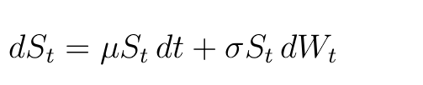
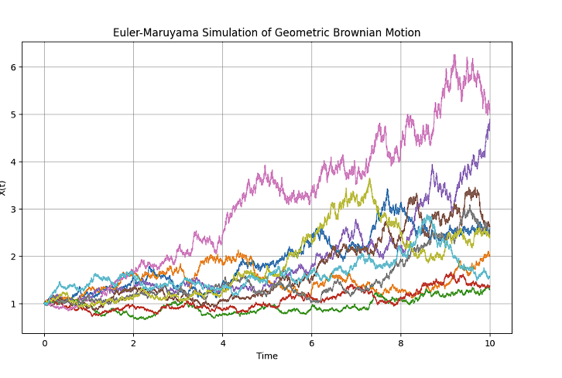
The Importance of Stochastic models
SDG
Application of the model
Stochastic models in finance
Geometric Brownian Motion
St is the stock price at time t, µ the expected return, σ the volatility of the stock and dWt the random fluctuations
Two methods to solve it: Euler Maruyama and Milstein’s method
Euler Maruyama simulation of the random process over time

Slide 13
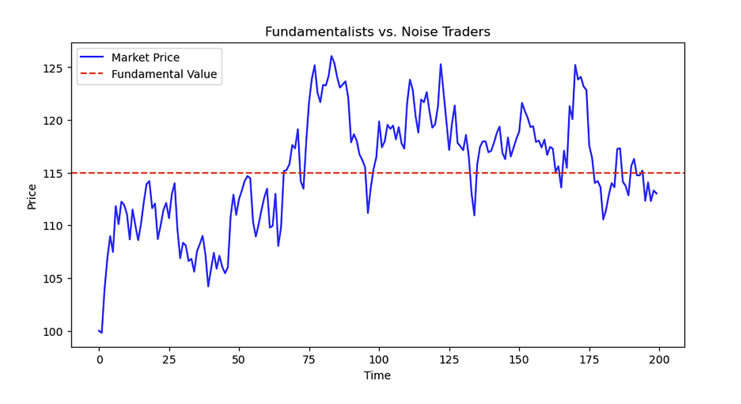
The Importance of Stochastic models
SDG
Application of the model
Stochastic models in finance
The EMH
Asset prices fully reflect all available information
Fundamentalist, followers of the EMH
Artificial market shows that the EMH does not hold

Slide 14
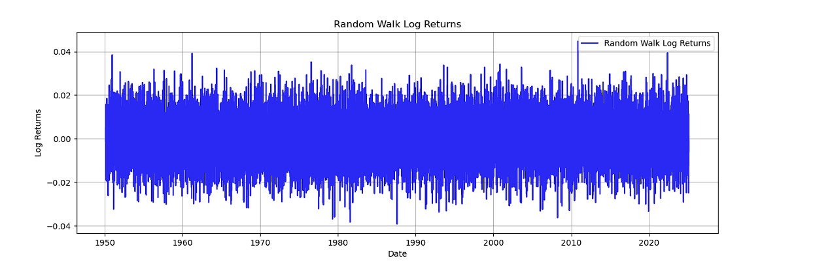
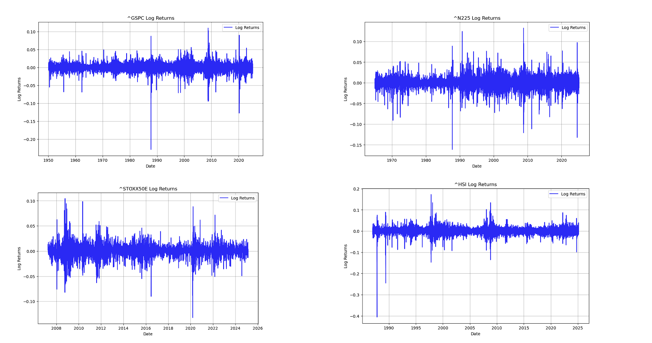
The Importance of Stochastic models
SDG
Application of the model
Stochastic models in finance
Real financial time series
Random walk log returns
Log returns from the SP500, NIKKEI, EUROSTOXX50 and HSI, respectively
Larger jumps appear in real markets

Slide 15
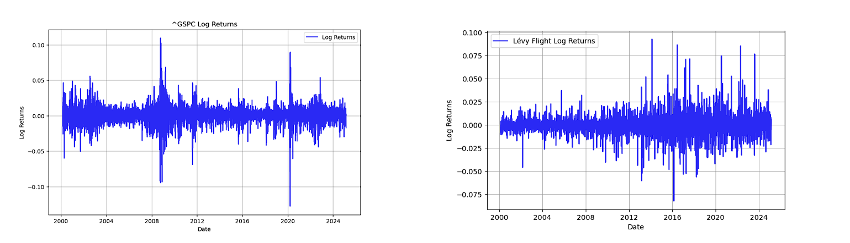
The Importance of Stochastic models
SDG
Application of the model
Stochastic models in finance
Levy flights
These jumps are better modelled trough Levy flights, which allow for sudden changes

Slide 16
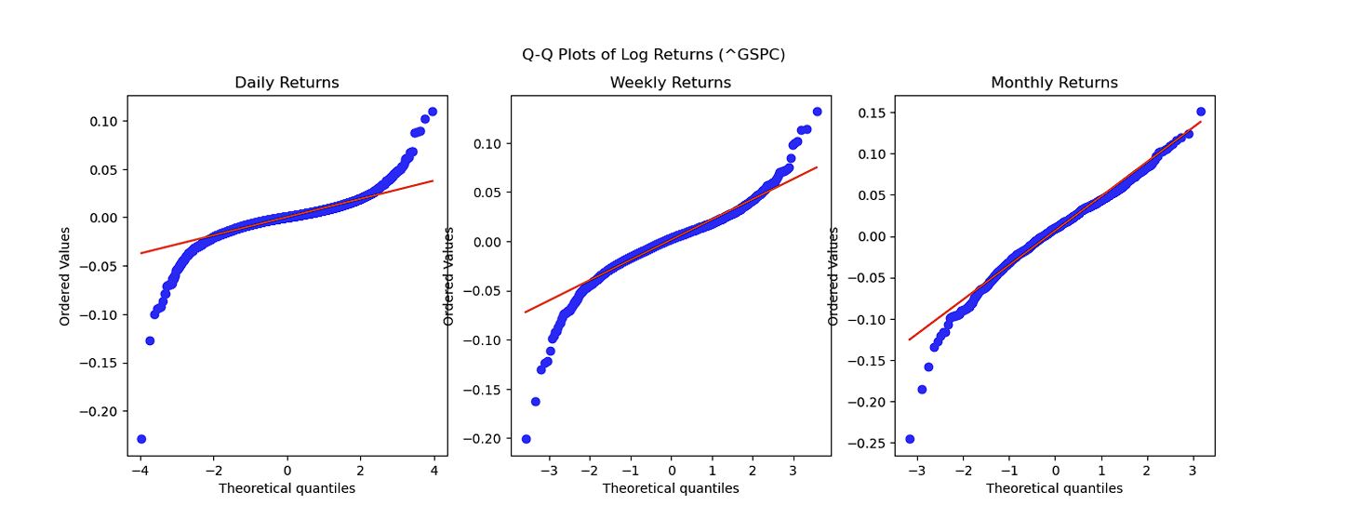
The Importance of Stochastic models
SDG
Application of the model
Stochastic models in finance
Levy flights
Low frequency data shows aggregational Gaussanity

Slide 17
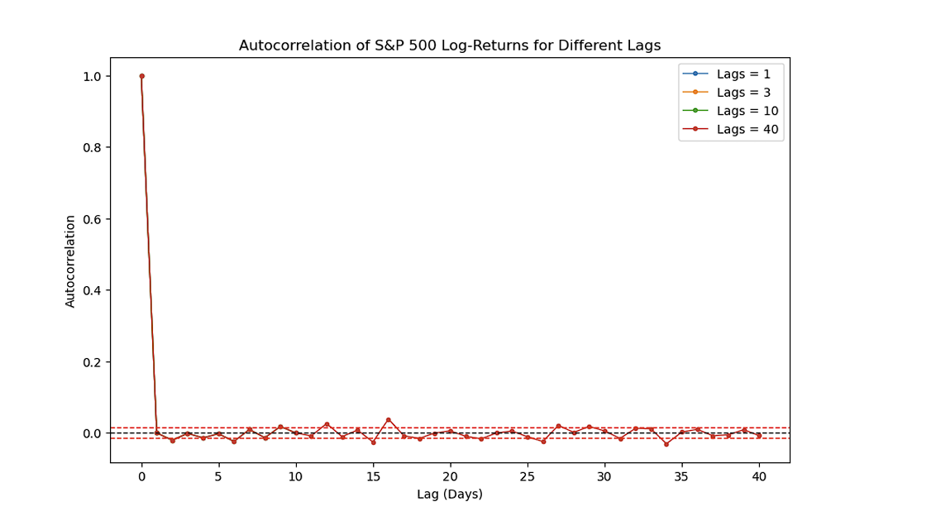
The Importance of Stochastic models
SDG
Application of the model
Stochastic models in finance
Do markets have memory?
No memory in raw log returns

Slide 18
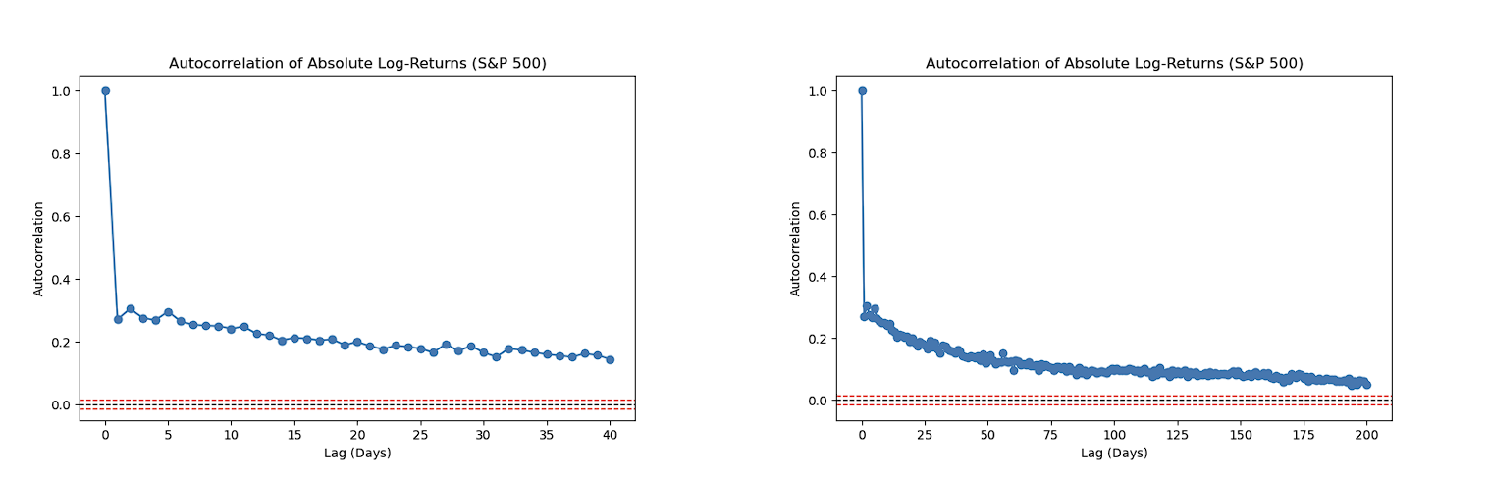
The Importance of Stochastic models
SDG
Application of the model
Stochastic models in finance
Do markets have memory?
Memory in absolute log returns – they show memory for volatility: volatility clustering

Slide 19
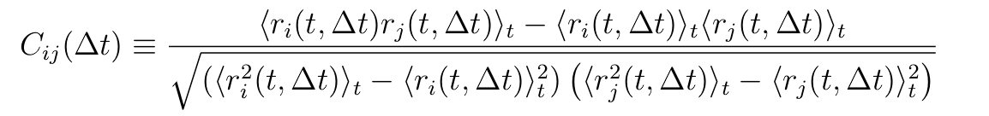
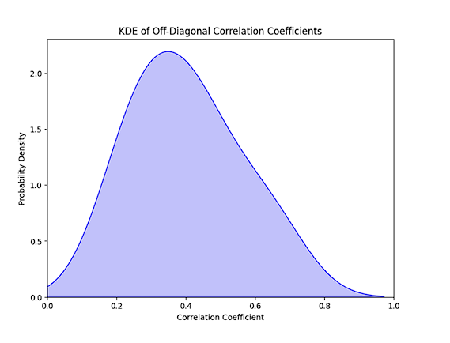
The Importance of Stochastic models
SDG
Application of the model
Stochastic models in finance
Multiple financial time series
Correlation across multiple stocks
Correlation between SP500, NIKKEI, HSI, EUROSTOXX50

Slide 20
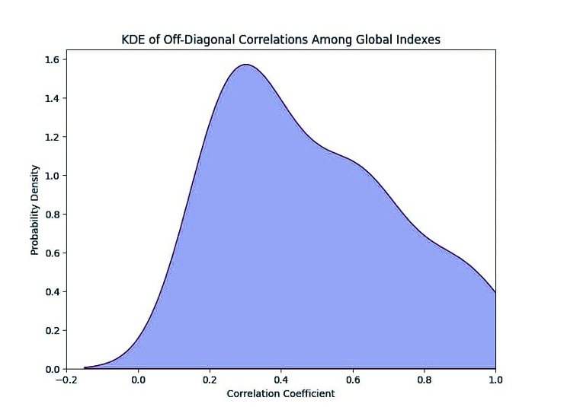
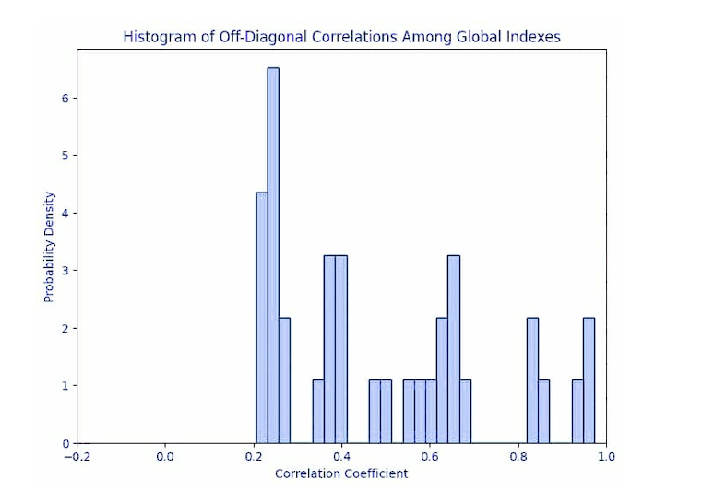
The Importance of Stochastic models
SDG
Application of the model
Stochastic models in finance
Multiple financial time series
Correlation between 15 global stocks
Less correlation: similar demographic background implies more correlation
Conclusion: Correlation still appears in all markets!

Slide 21
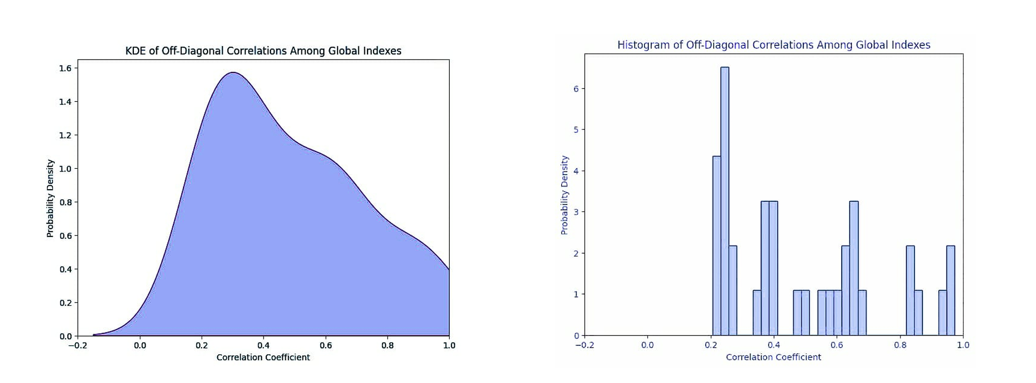
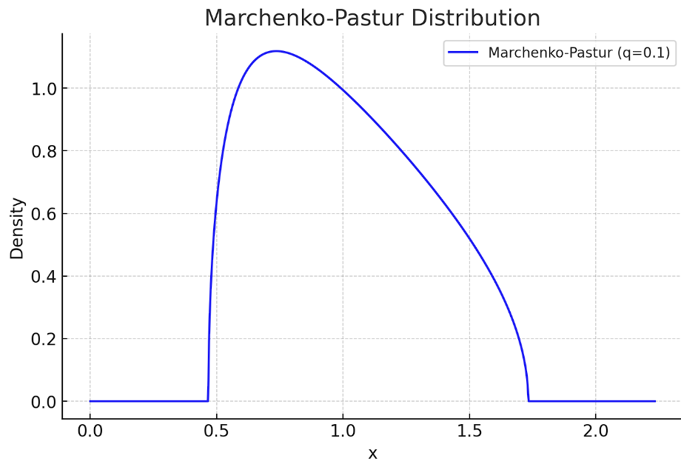
The Importance of Stochastic models
SDG
Application of the model
Stochastic models in finance
Multiple financial time series
Introduction of Random Matrix Theory (RMT)
Distinguish between true correlations and random noise
Marchenko-Pastur distribution

Slide 22
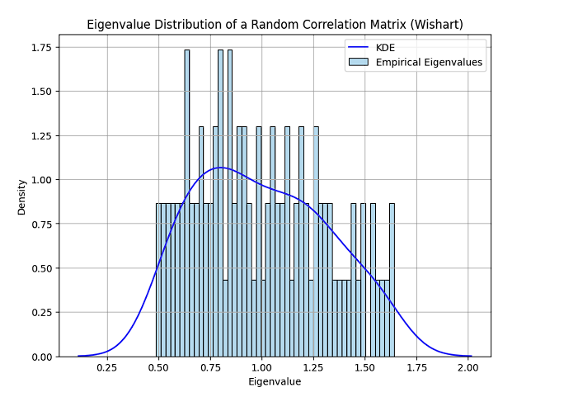
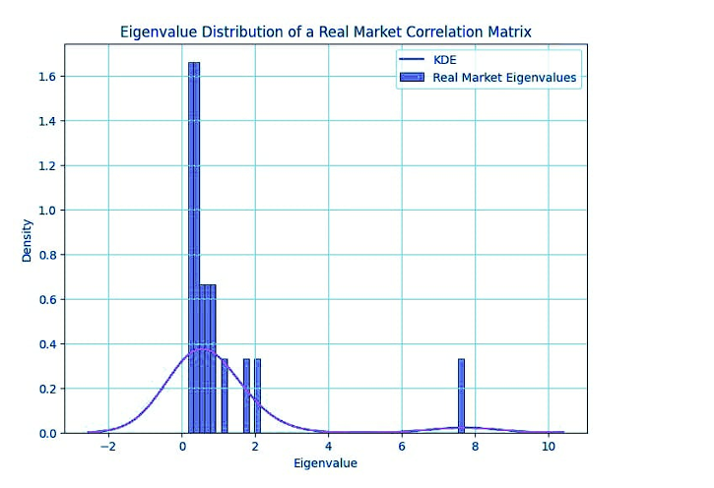
The Importance of Stochastic models
SDG
Application of the model
Stochastic models in finance
Multiple financial time series
Correlation matrix and KDE plot built from 100 random time series
Follows theoretical bounds
Correlation matrix and KDE plot built from real time series
Larger dominant eigenvalue: market mode

Slide 23
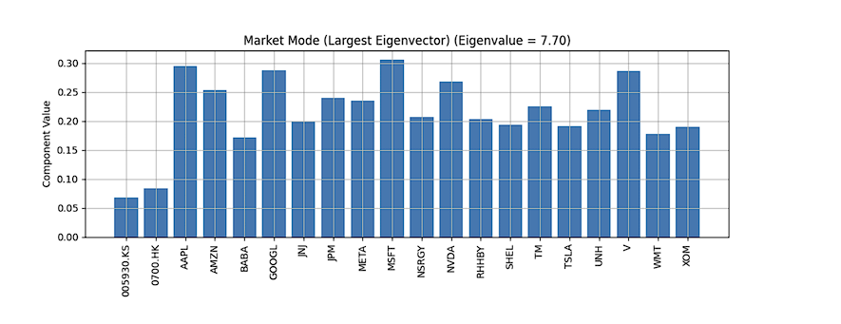
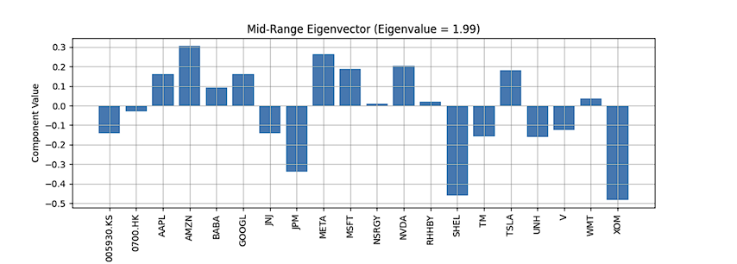
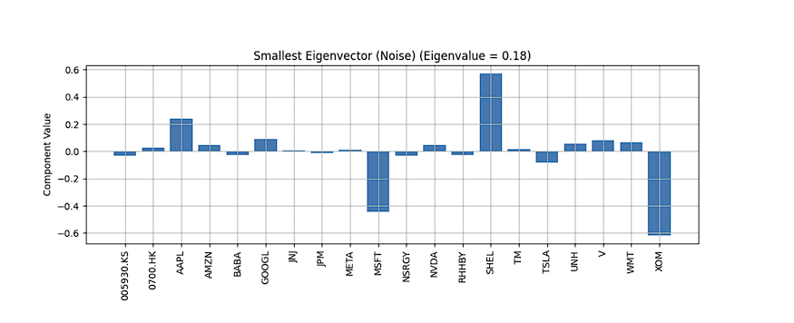
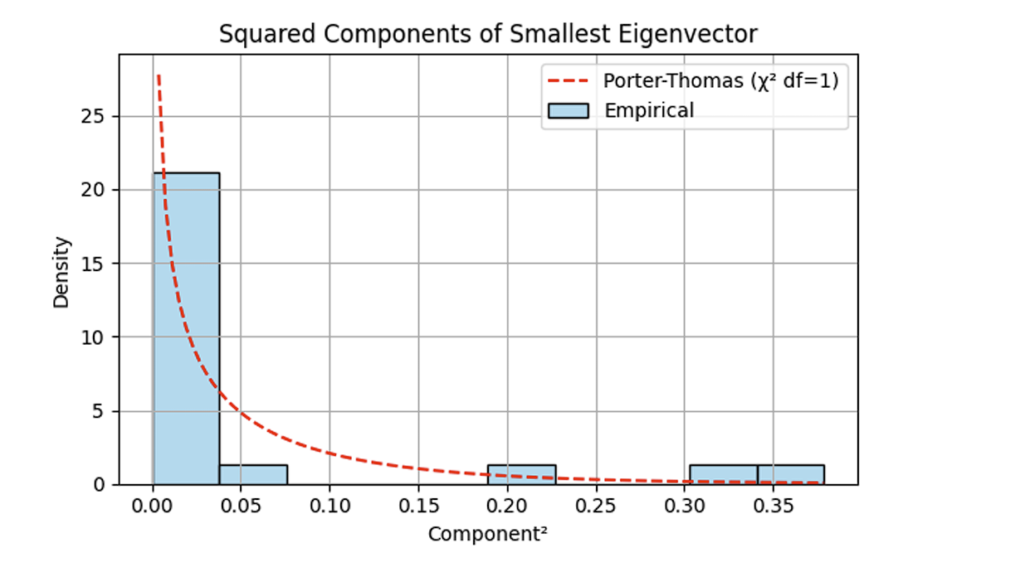
The Importance of Stochastic models
SDG
Application of the model
Stochastic models in finance
Multiple financial time series
Outlier eigenvalues show sectoral patterns
Bulk and small eigenvalues show noise
Stocks follow the same direction in the largest eigenvalue : the mode
Very straightforward approach to filter the eigenvalue corresponding to noise

Slide 24
The Importance of Stochastic models
SDG
Application of the model
Stochastic models in finance
Multiple financial time series
Outlier eigenvalues show sectoral patterns
Bulk and small eigenvalues show noise
Stocks follow the same direction in the largest eigenvalue : the mode
Very straightforward approach to filter the eigenvalue corresponding to noise

Slide 25
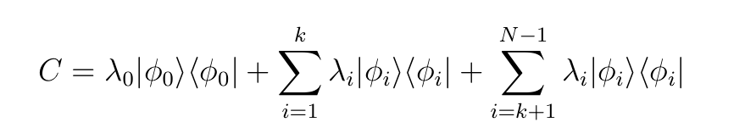
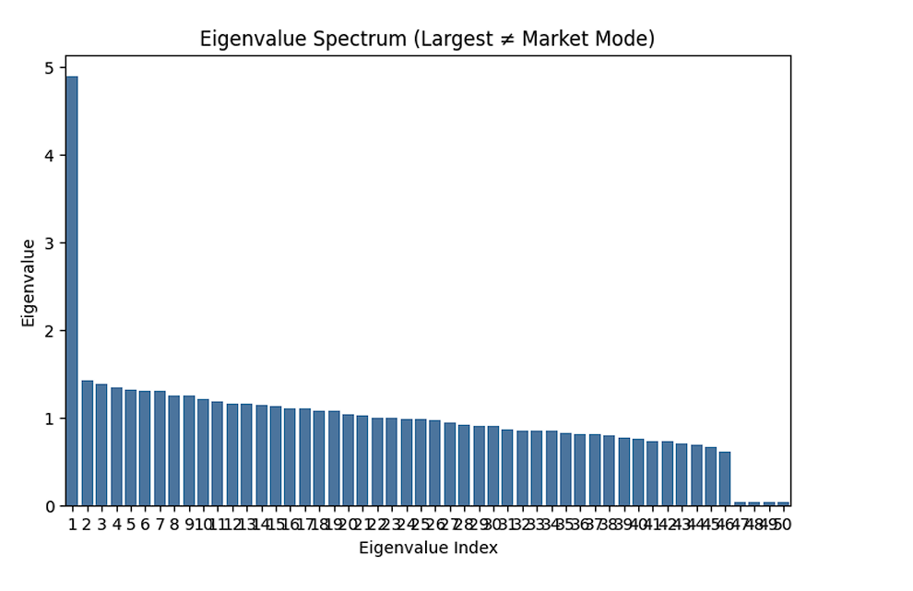
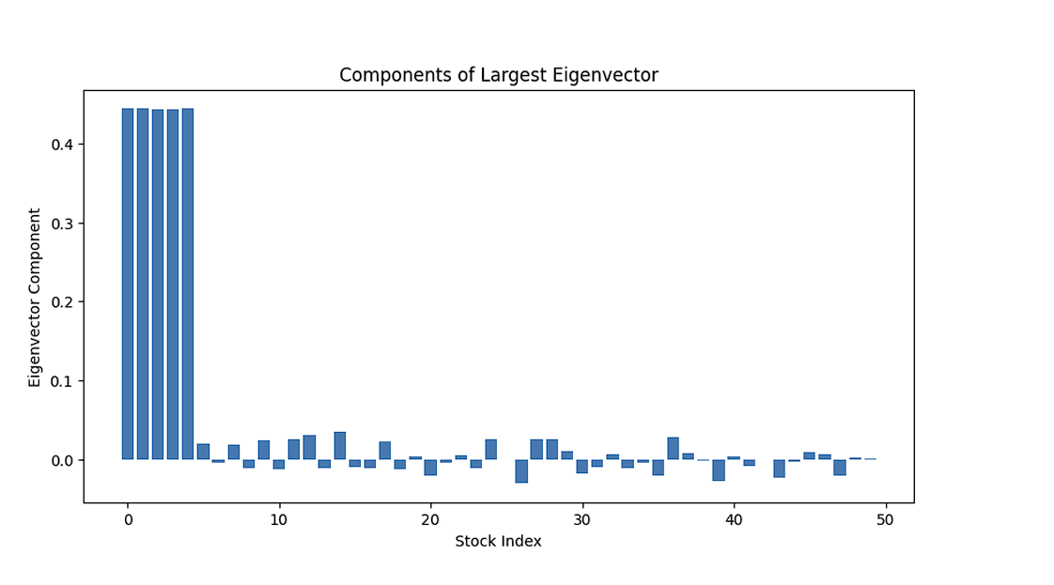
The Importance of Stochastic models
SDG
Application of the model
Stochastic models in finance
Correlation filtering
Eigenvalue descomposition: Mode, Sector and Noise
Sometimes largest eigenvalue does not correspond to the mode. This graph reflects a sector where few components only influence it : sectoral behaviour

Slide 26
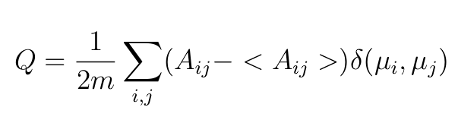
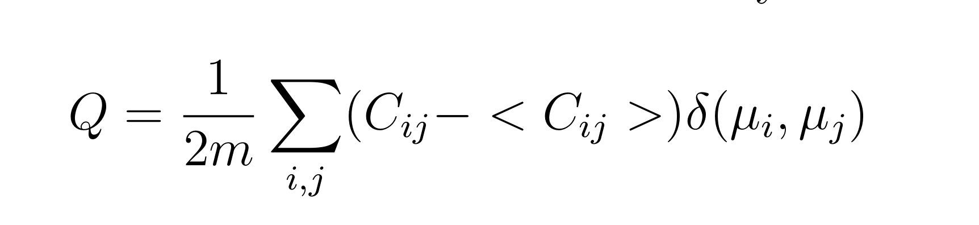
The Importance of Stochastic models
SDG
Application of the model
Stochastic models in finance
Correlation filtering
RMT !

Slide 27
Introduction / Motivation
The Importance of Stochastic models
Stochastic models in finance
Application of the model
Conclusions

Slide 28
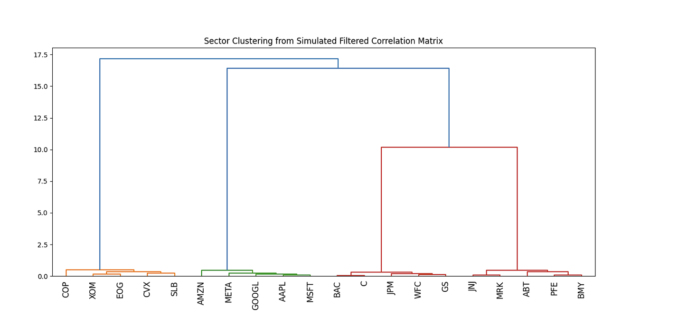
The Importance of Stochastic models
SDG
Application of the model
Application of the model

Slide 29
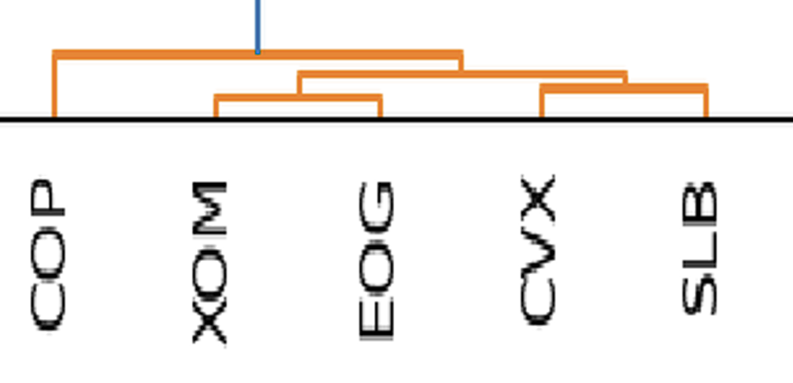
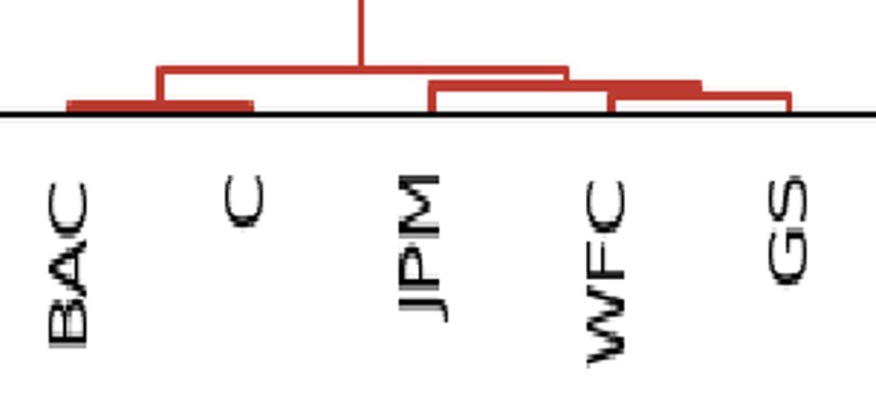
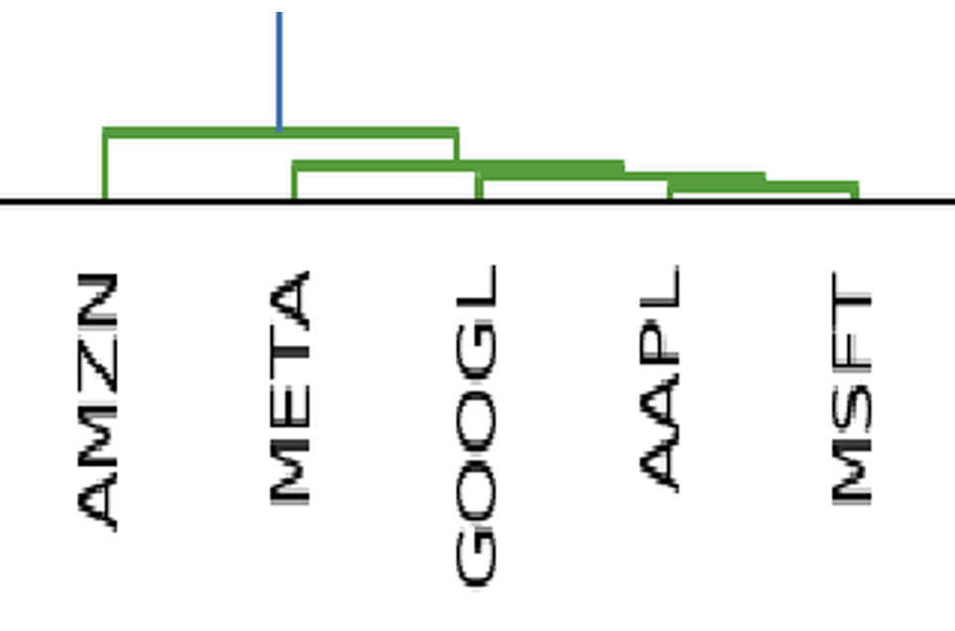
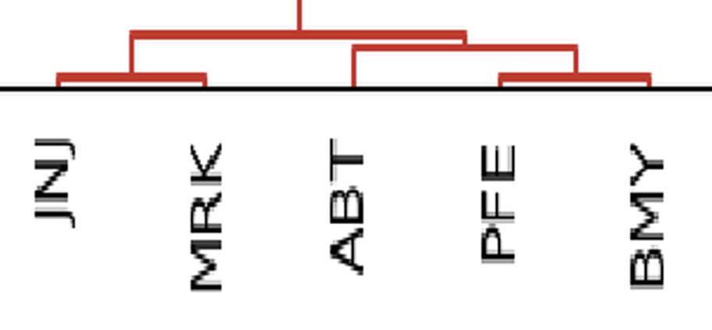
The Importance of Stochastic models
SDG
Application of the model
Application of the model
Energy sector
U.S banks sector
Technology sector
Pharmaceutical and Healthcare sector

Slide 30
Introduction / Motivation
The Importance of Stochastic models
Stochastic models in finance
Application of the model
Conclusions

Slide 31
The Importance of Stochastic models
SDG
Conclusions
Tools from physics can help understand financial markets
Brownian motion as a good starting point, but lack ability to capture extreme events
Levy flights good basic model for high frequency data
Need for complex systems to capture real time financial markets
Random Matrix Theory + Optimization tecniques
These tools as a baseline for Modern Portfolio Theory (Future work)
We have created a path from fundamental theories to complex systems in Econophysics !

Slide 32

Table of contents
The Importance of Stochastic models
Stochastic models in finance
SDG
Conclusions
Application of the model
Thank you for your attention
Author: Jon Rodriguez Gonzalez
Degree: Physics
Academic year: 2024-2025
SDG: 8,9,10,17

